Slide 1
CS2422 Assembly Language & System Programming
December 11, 2003

Slide 2
Today’s Topics
Algorithm and Data Structure for a Linking Loader

Slide 3
Study Guide
Section 3.2.3

Slide 4
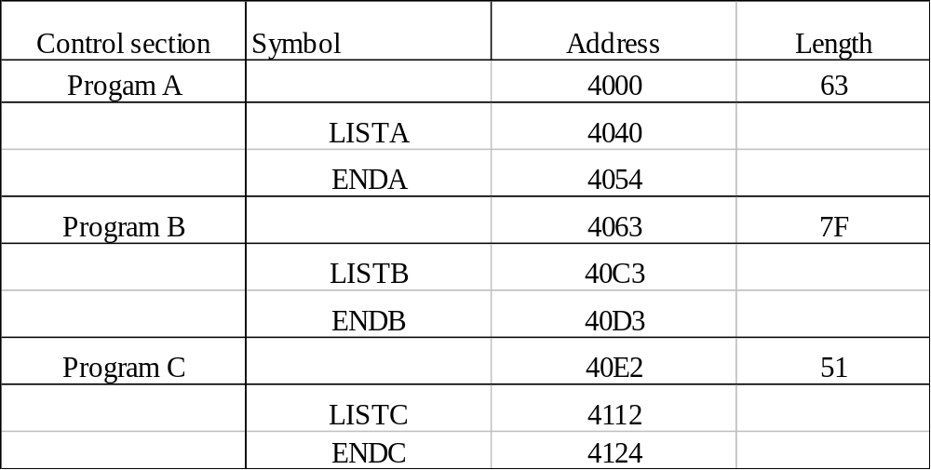
Algorithm and Data Structure
Two Passes Logic
  Pass 1: Assign addresses to all external symbols
  Pass 2: Perform the actual loading, relocation, and linking
ESTAB (external symbol table)
+
+

Slide 5
Pass 1 Program Logic
Pass 1:
  Assign addresses to all external symbols
Variables & Data structures
  PROGADDR (program load address) from OS
  CSADDR (control section address)
  CSLTH (control section length)
  ESTAB
Fig. 3.11(a)
  Process Define Record

Slide 6
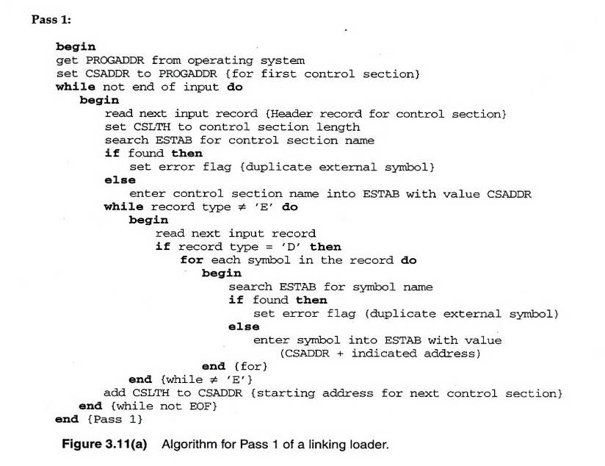
Fig. 3.11(a)

Slide 7
Pass 2 Program Logic
Pass 2:
  Perform the actual loading, relocation, and linking
Modification record
  Lookup the symbol in ESTAB
End record for a main program
  Transfer address
Fig. 3.11(b)
  Process Text record and Modification record

Slide 8
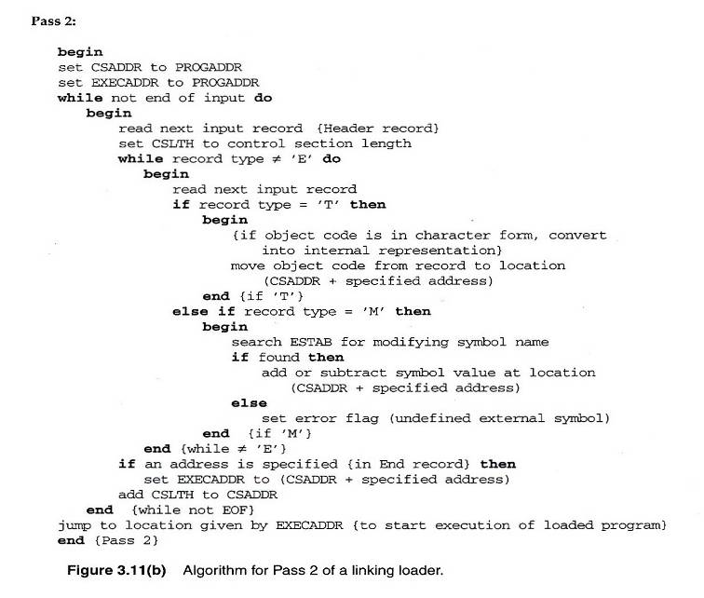
Fig. 3.11(b)

Slide 9
Improve Efficiency
Use local searching instead of multiple searches of ESTAB for the same symbol
  Assign a reference number to each external symbol
  The reference number is used in Modification records
Implementation
  01: Control section name
  Other: External reference symbols
Example
  Fig. 3.12

Slide 10
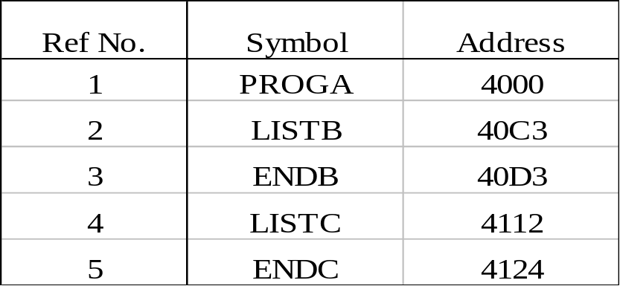
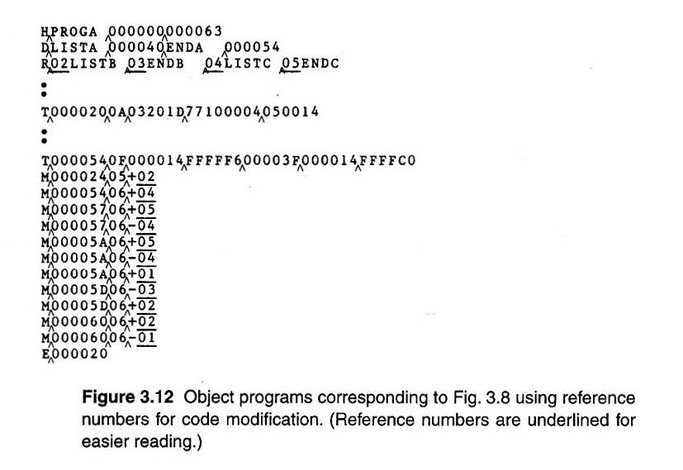
Fig. 3.12 (1/3)

Slide 11
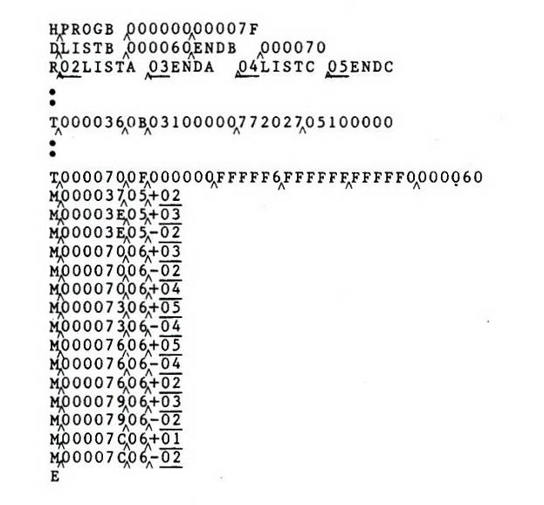
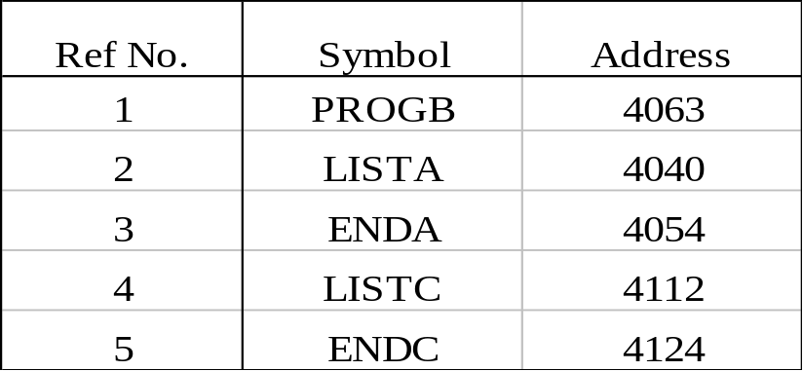
Fig. 3.12 (2/3)

Slide 12
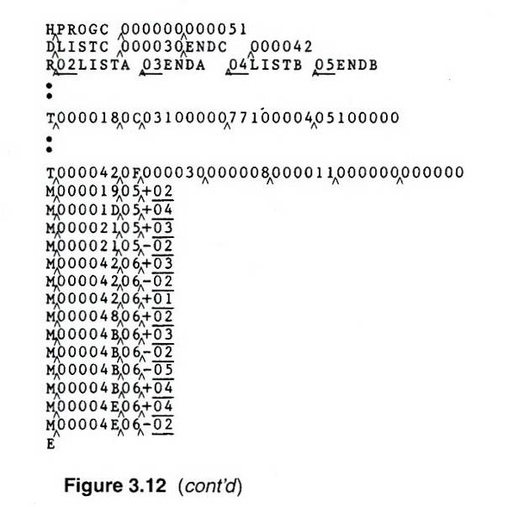
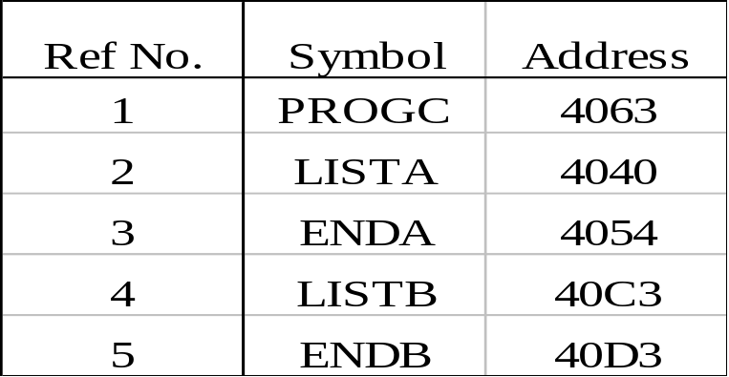
Fig. 3.12 (3/3)

Slide 13
Homework Assignment #6
Due Day : 23:59, January 5, 2004
SIC/XE Linking Loader
  In this homework, you are required to design a two-pass SIC/XE linking loader. You can refer to Figure 3.11. The input of the linking loader is an object file that contains several object programs. The input file format is similar to that of Figure 3.9. The output is a memory dump which is similar to that of Figure 3.10(a).

